Slide 1

Deep Learning & LLMs 2
Applied Text Mining & NLP
from Foundations to Advanced
Robert Bagheri
2026
Notes:
Video by Google DeepMind from Pexels: https://www.pexels.com/video/an-artist-s-animation-of-artificial-intelligence-ai-this-video-depicts-language-models-which-generate-text-it-was-created-by-wes-cockx-as-part-of-the-visualising-ai-project-launched-by-18069700/

Slide 2
This lecture
Neural networks 2
Convolutional neural networks
State-of-the-art methods

Slide 3
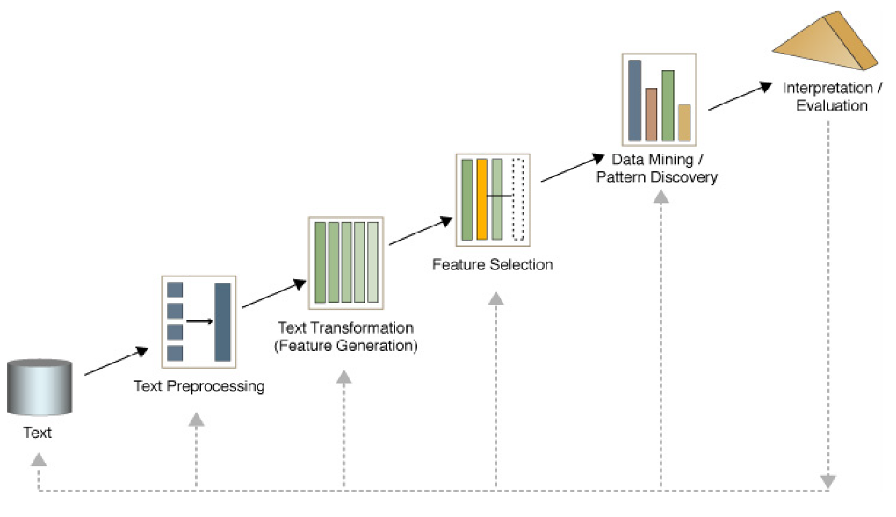
Text mining process

Slide 4
Introduction

Slide 5
Why should we learn this?
State-of-the-art performance on various tasks
Text prediction (your phone’s keyboard)
Forecasting
Spam filtering
Compression (dimension reduction)
Text generation
Translation
…

Slide 6
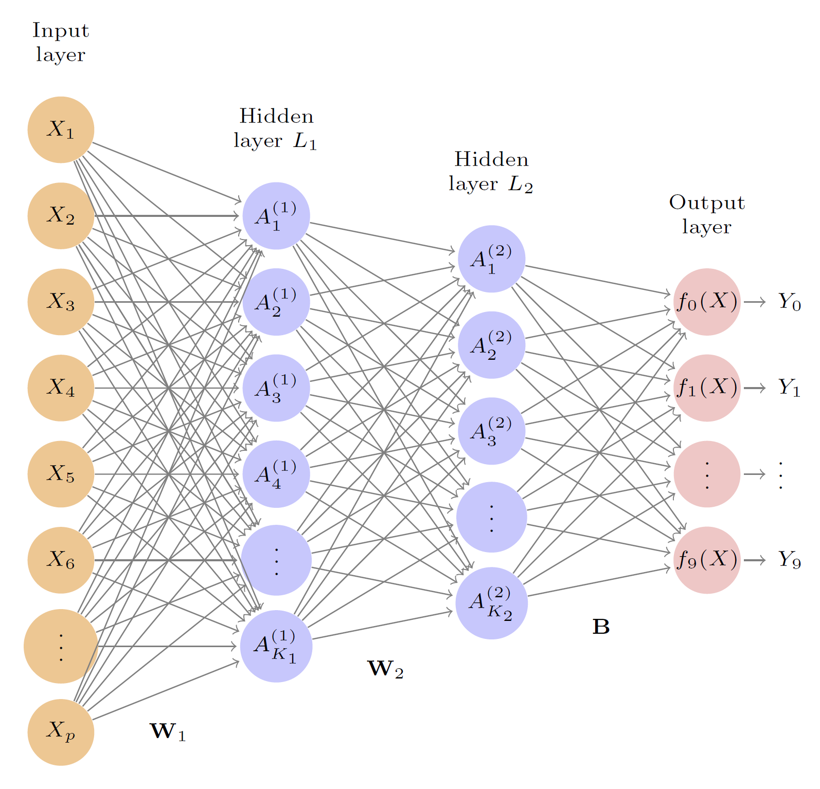
Feed-forward neural networks

Slide 7
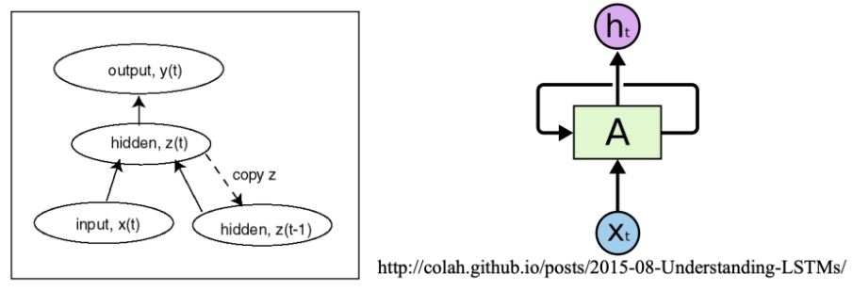
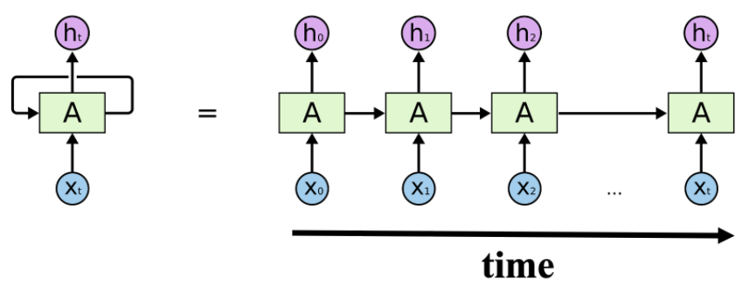
Simple recurrent network

Slide 8
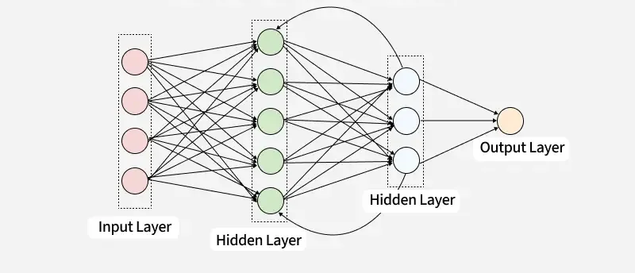
Recurrent neural network

Slide 9
Convolutional Neural Networks

Slide 10
What is a convolution?
Convolution is applying a kernel (filter) over data (text, image, etc.)
The kernel (filter) defines which feature is important in the data

Slide 11
What is a convolution?
https://github.com/vdumoulin/conv_arithmetic

Slide 12
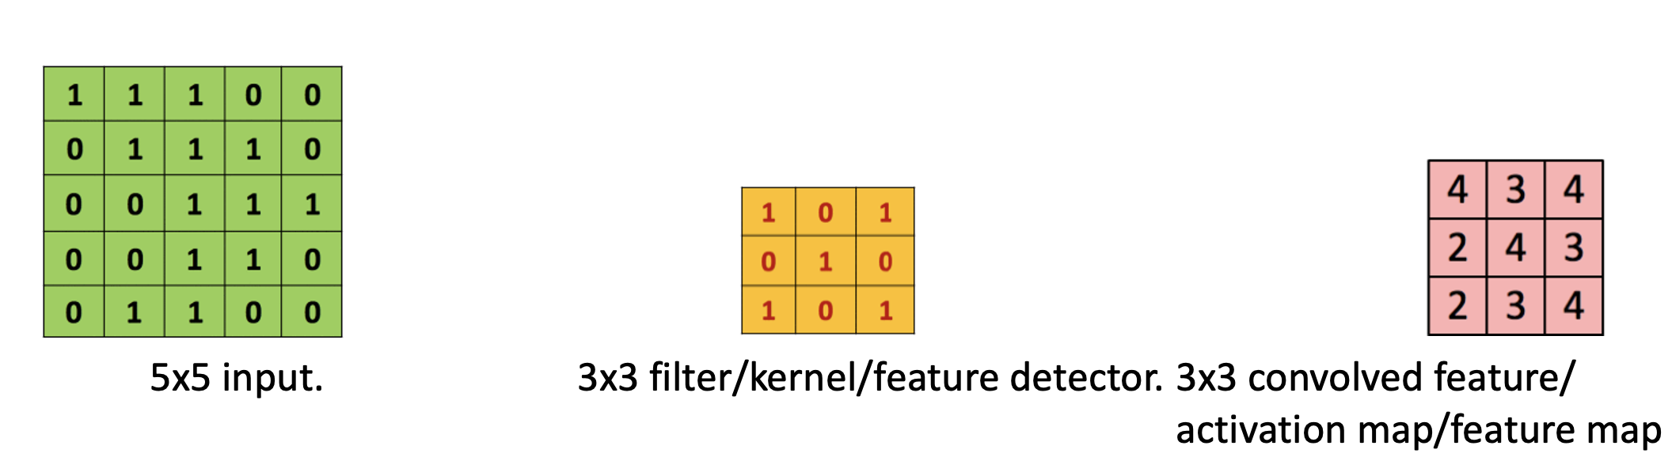
What is a convolution?

Slide 13
What is a convolution?

Slide 14
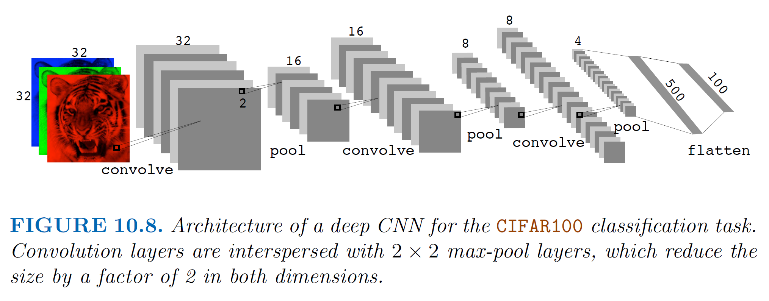
Convolution layers
A convolutional neural network is a NN with one or more convolution layers
The parameters / weights in a convolution layer are the elements of the filter
The filter is learnt by the network!

Slide 15
Pooling layer
Convolution layers are usually followed by a pooling layer
Reduces dimensionality
Location invariance: Robustness against pixel shift / small rotations
Max pool most common

Slide 16
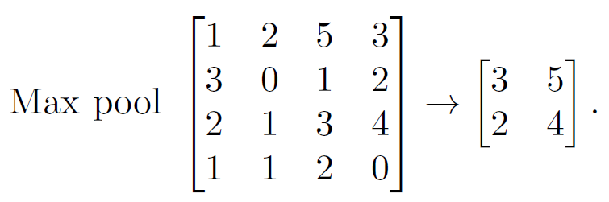
Pooling layer

Slide 17
Architecture of a CNN

Slide 18
Large Language Models

Slide 19
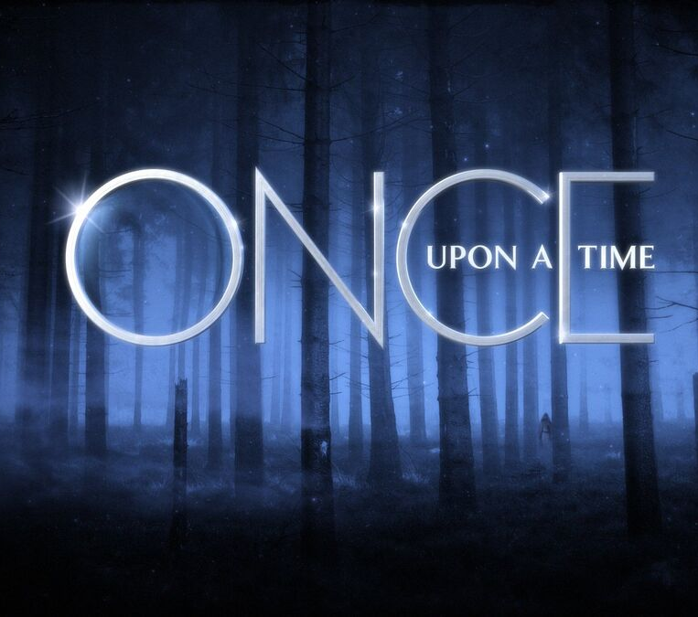
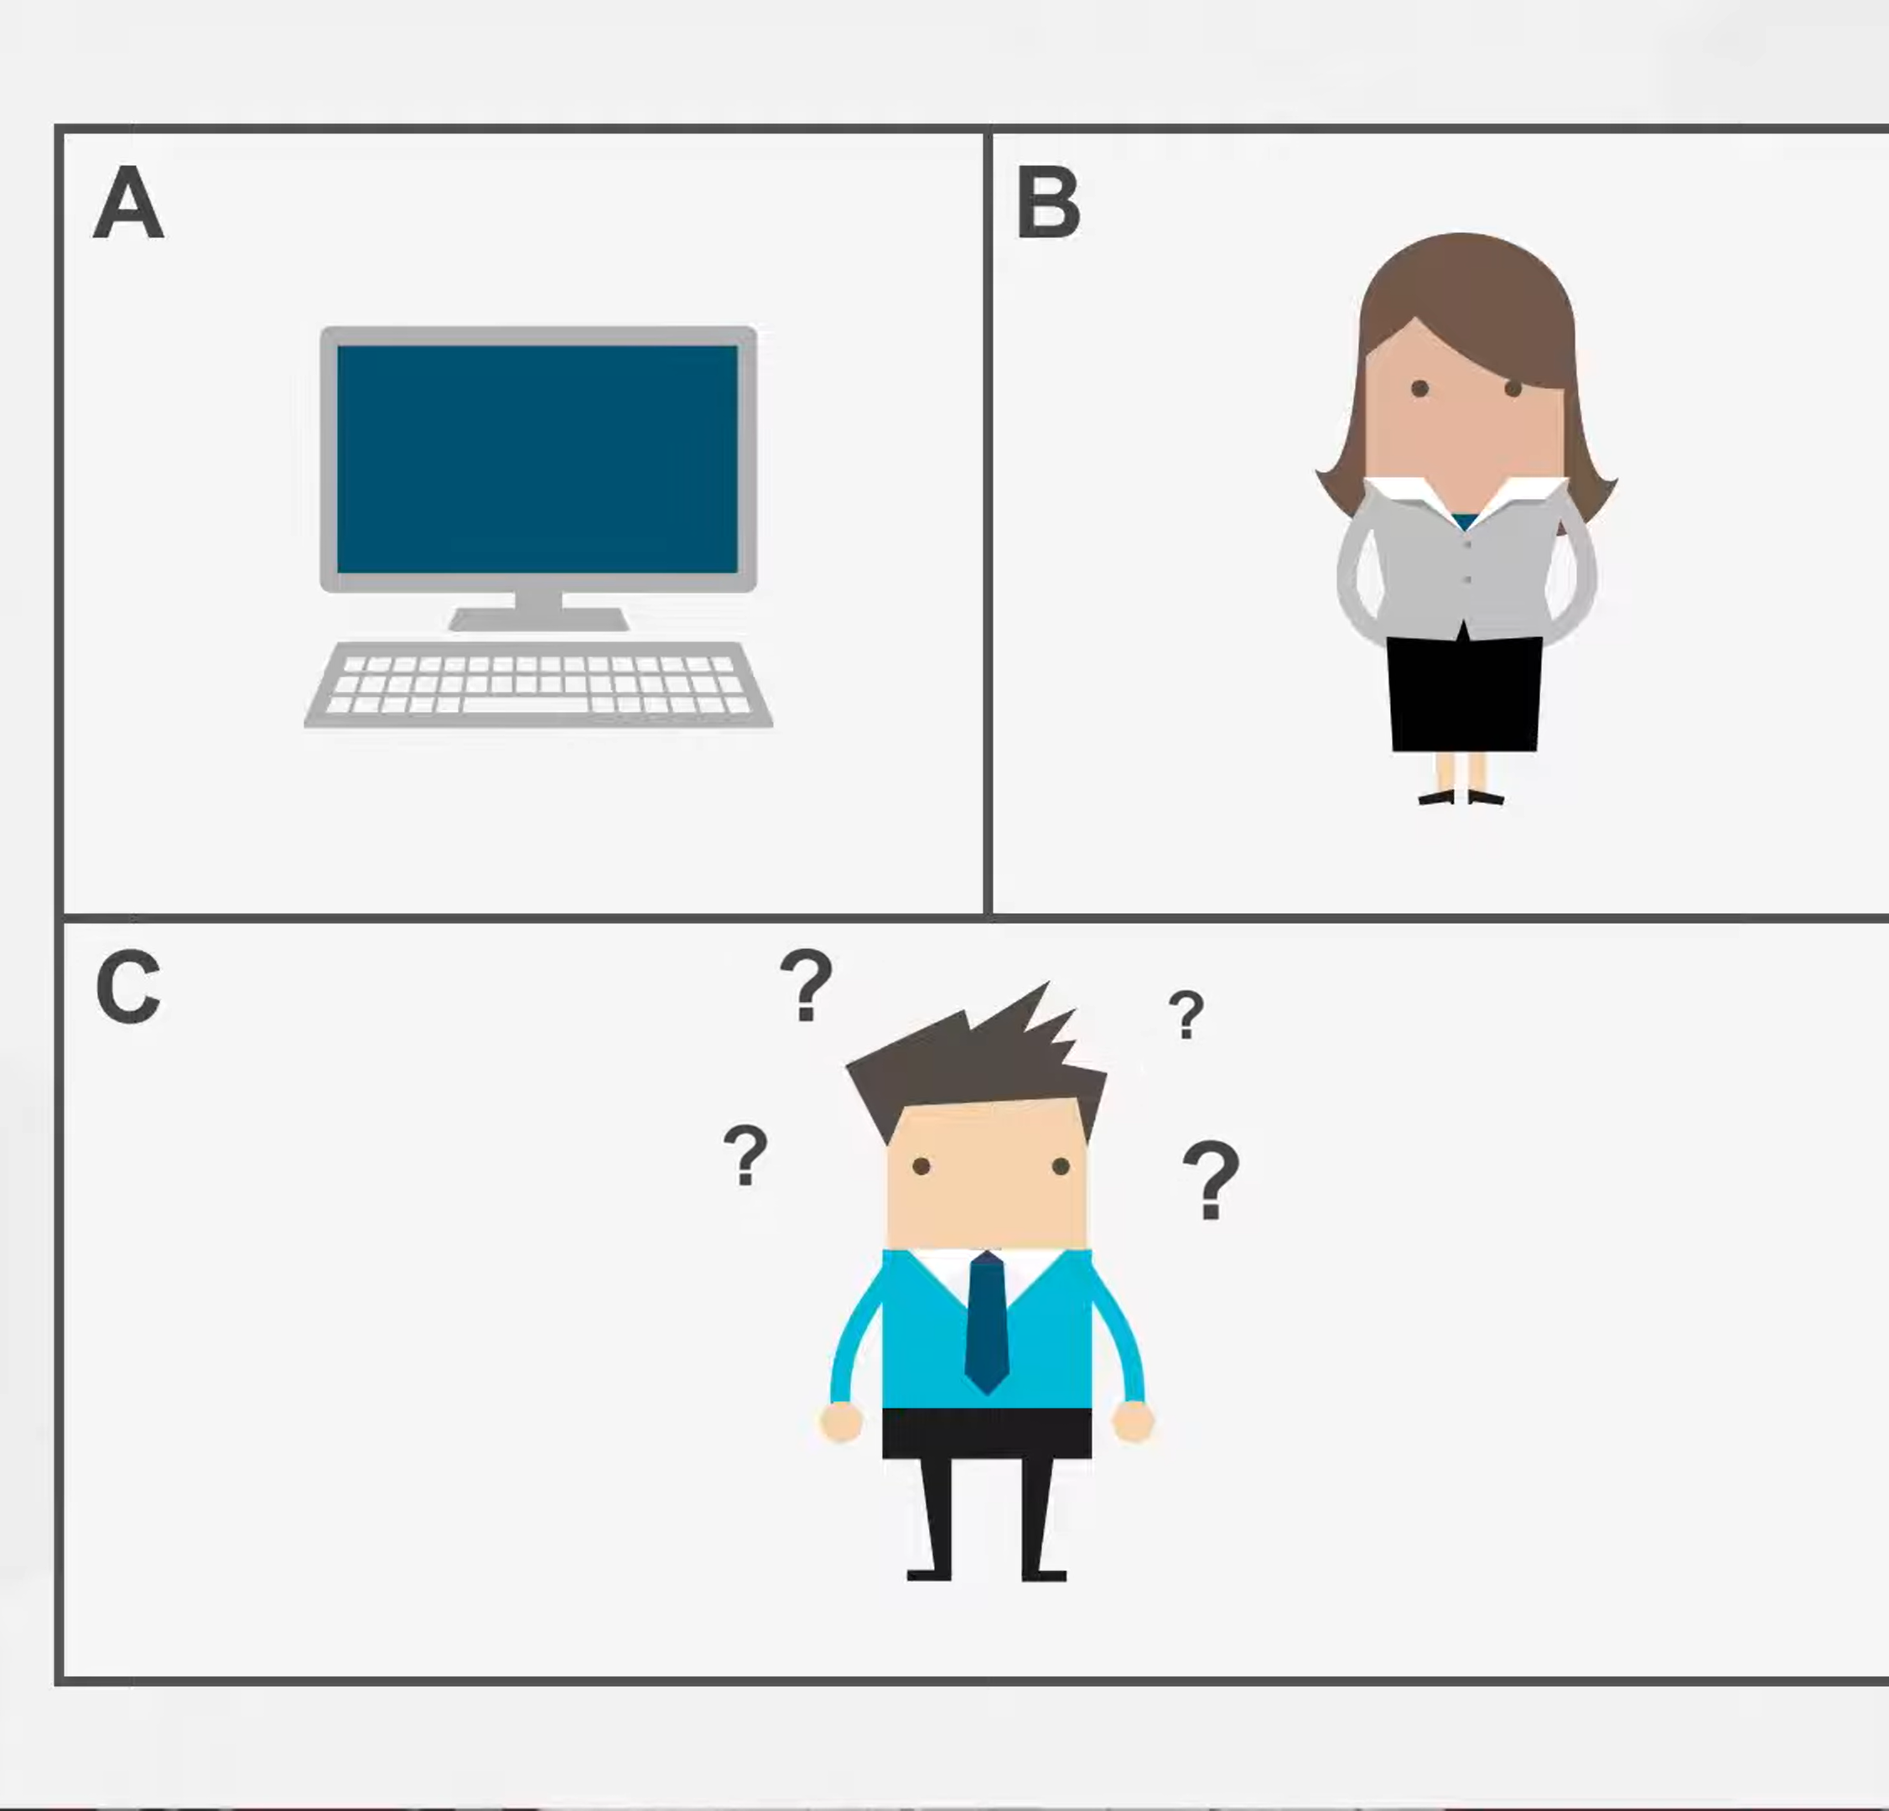

Slide 20
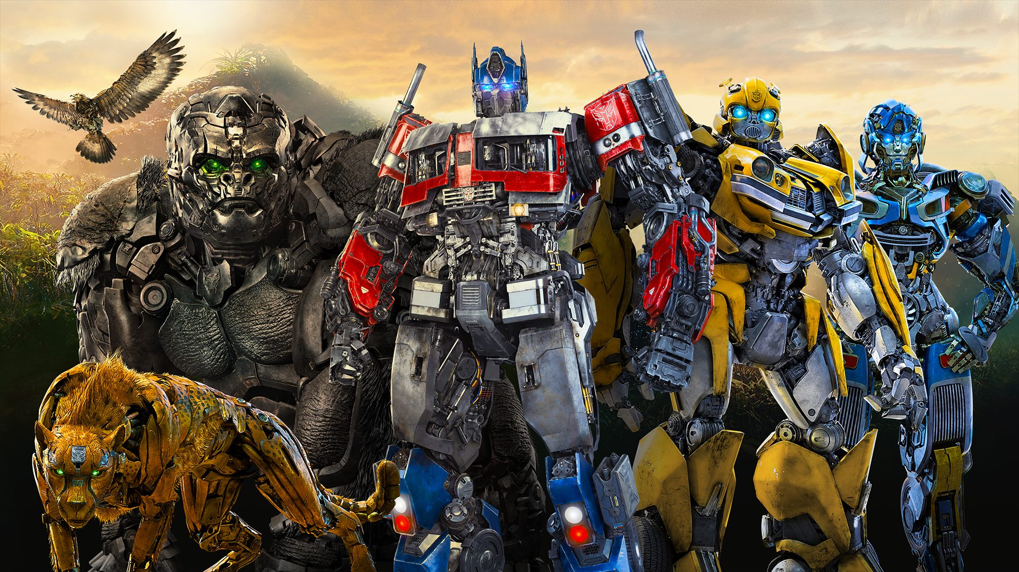
Transformers!

Slide 21
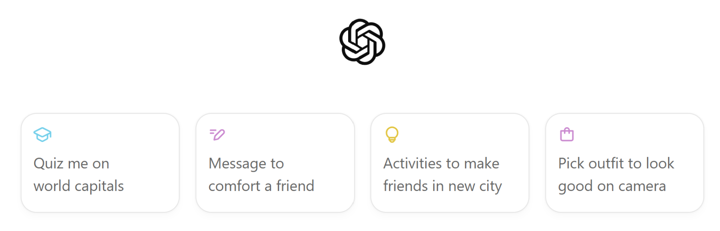
Large Language Models
ChatGPT4o

Slide 22
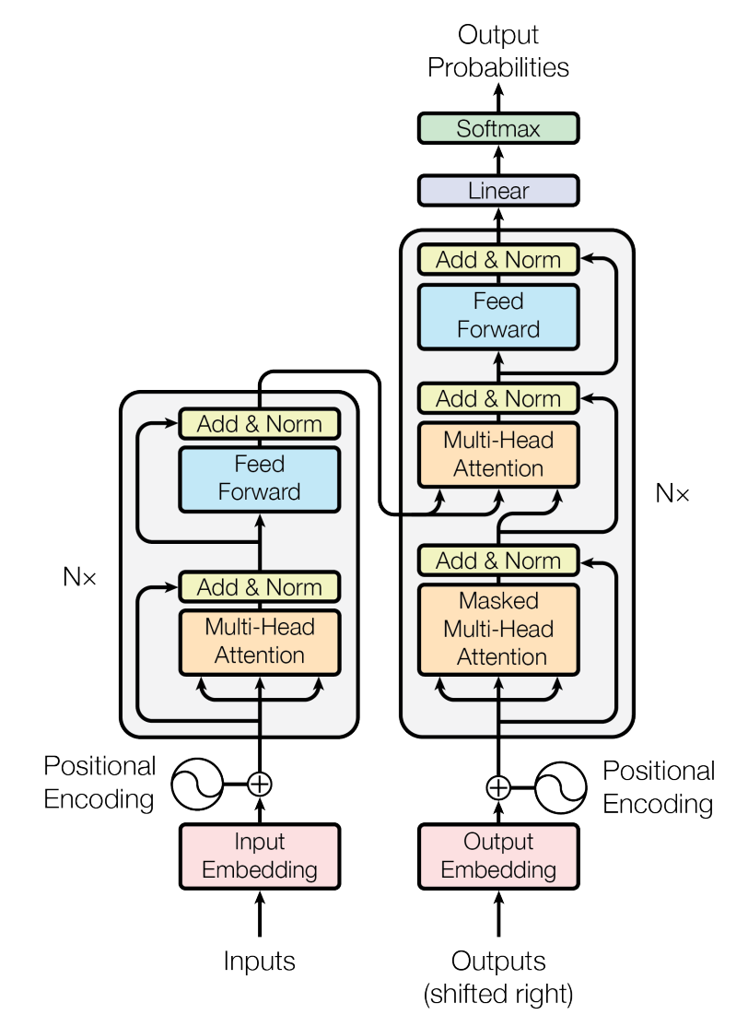
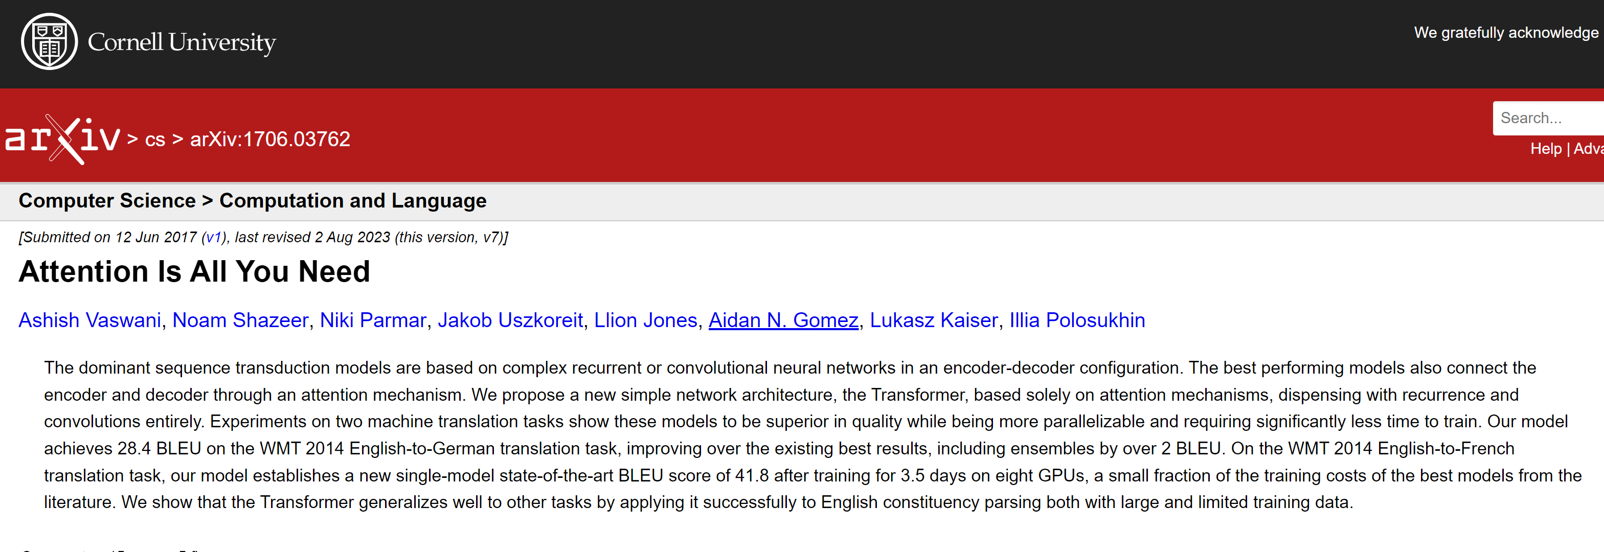
Transformers!
Bag-of-Words
Recurrent Neural Network
LSTM
Transformer
(LLM)

Slide 23
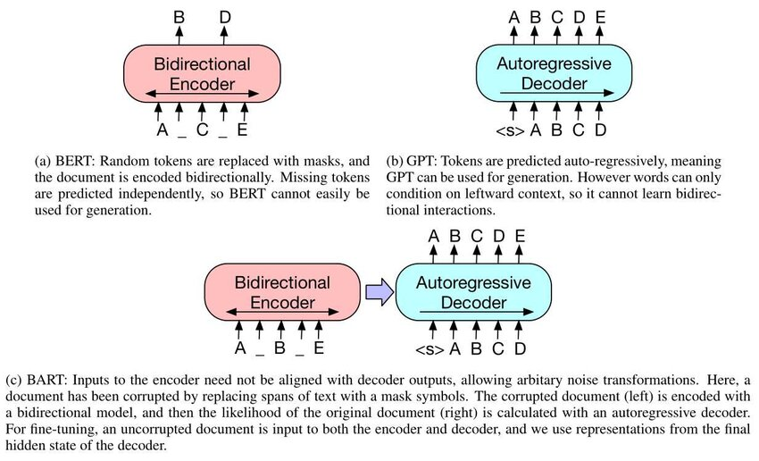
Transformer foundation models: BERT, GPT, BART
BERT: Bidirectional Encoder Representations from Transformers.
Masked word prediction, text representation
GPT: Generative Pre-trained Transformer.
Next word prediction, text generation, chat
BART = “BERT+GPT”: Bidirectional encoder and Auto-Regressive decoder Transformers.
Noised text reconstruction, summarization, translation, spelling correction

Slide 24
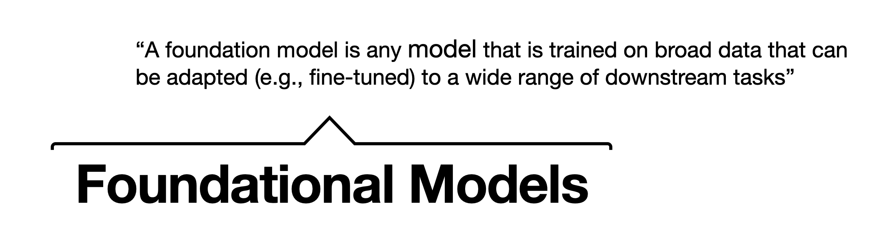
On the Opportunities and Risks of Foundation Models by Bommasani et al. 2022
https://arxiv.org/pdf/2108.07258

Slide 25
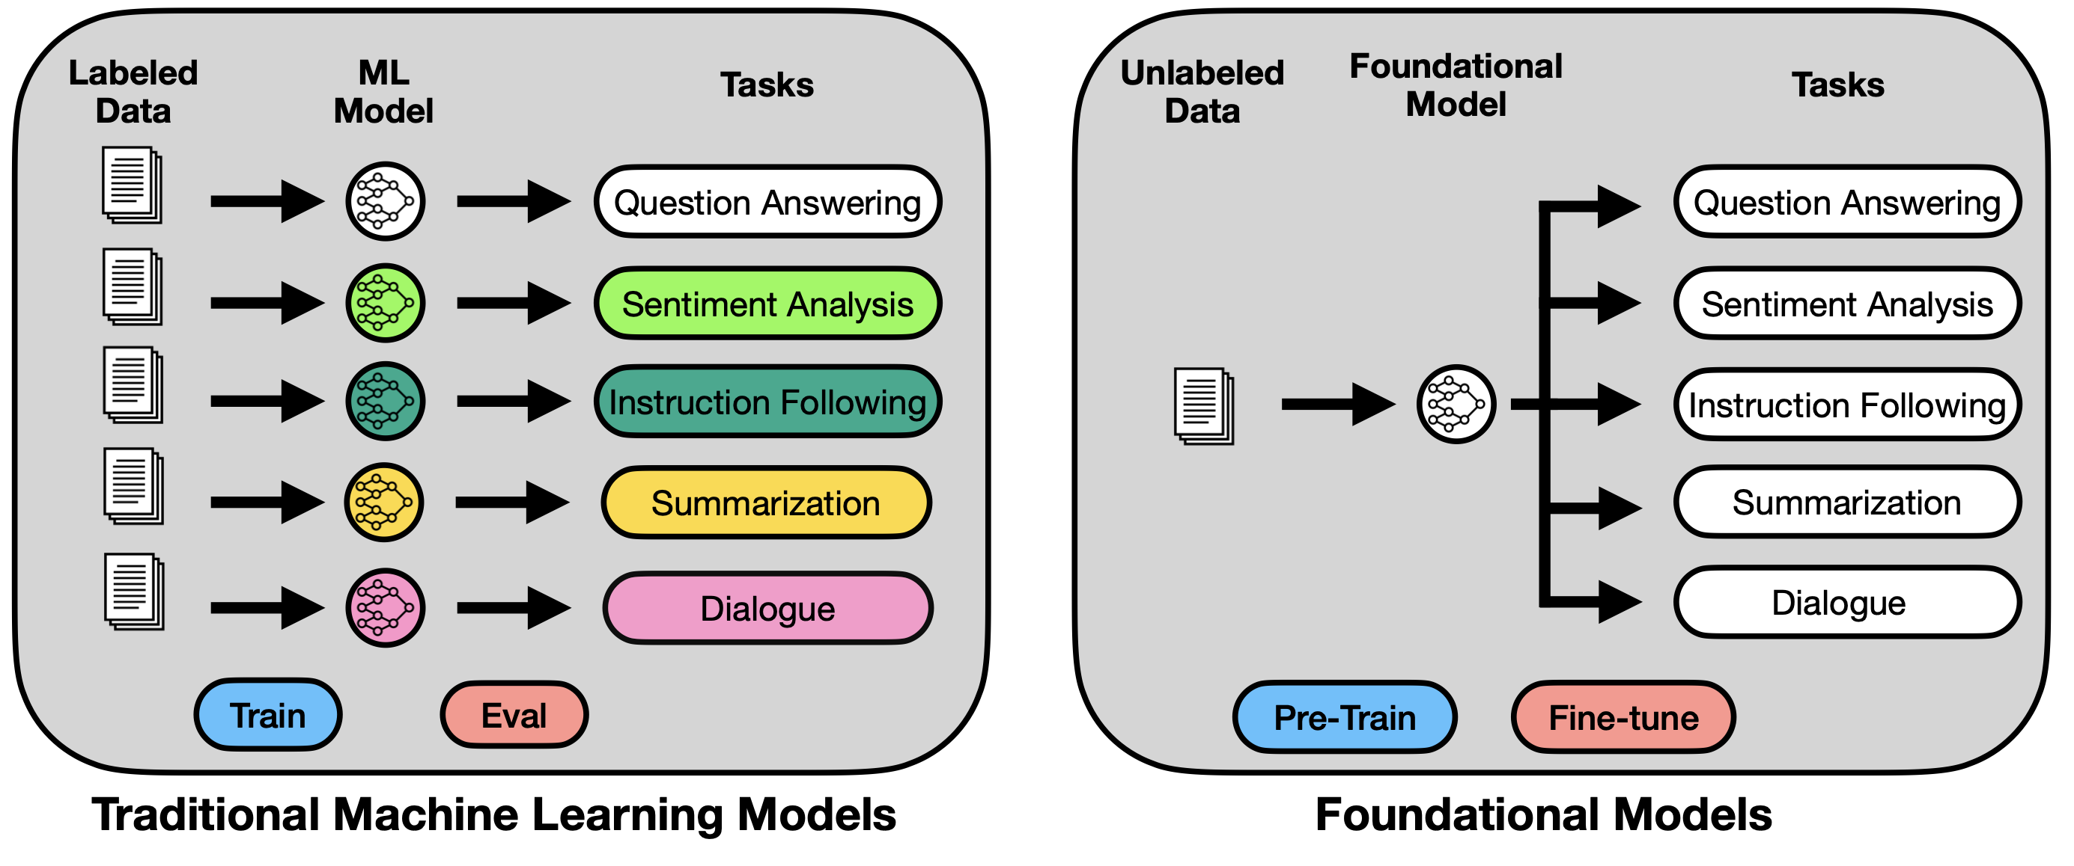
Foundational Models

Slide 26
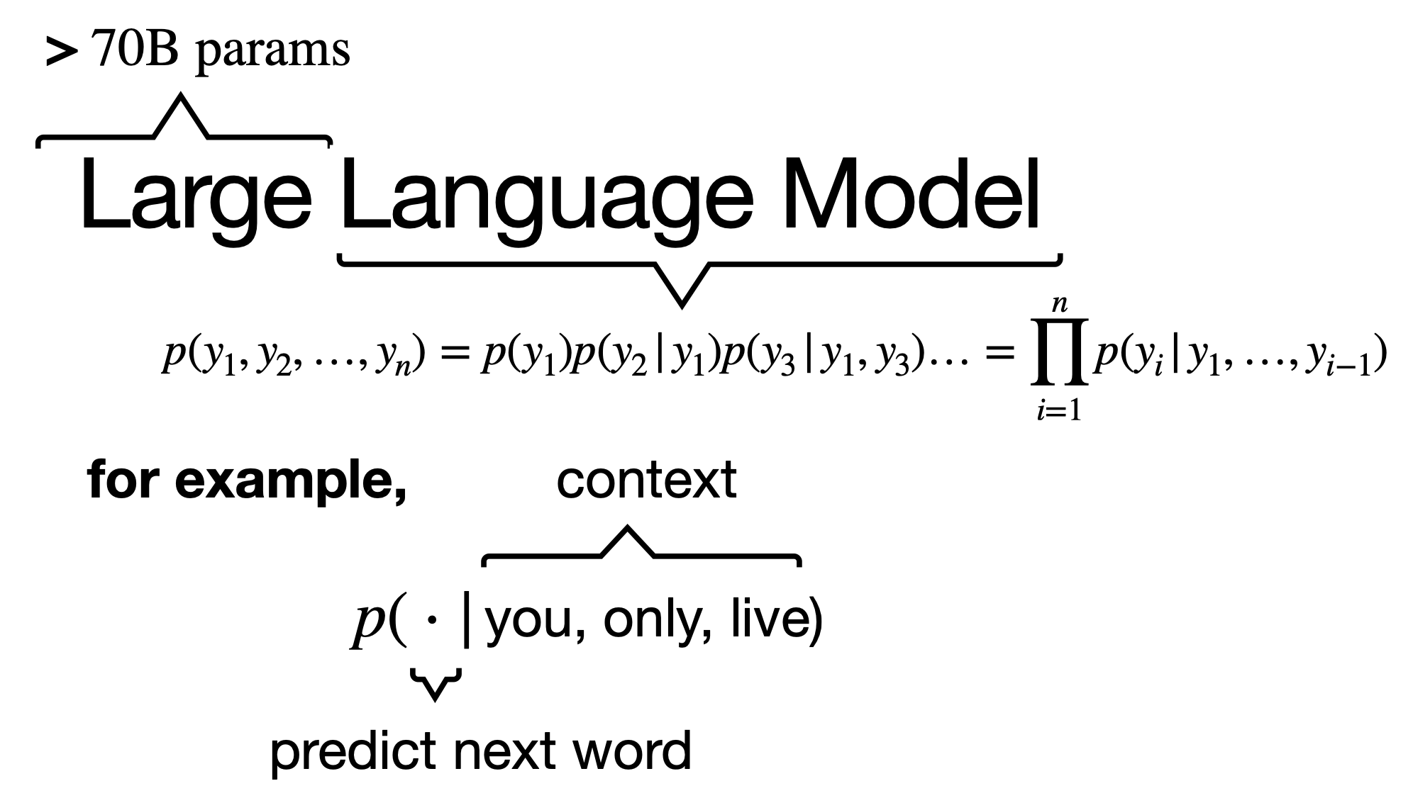
Foundational Models

Slide 27
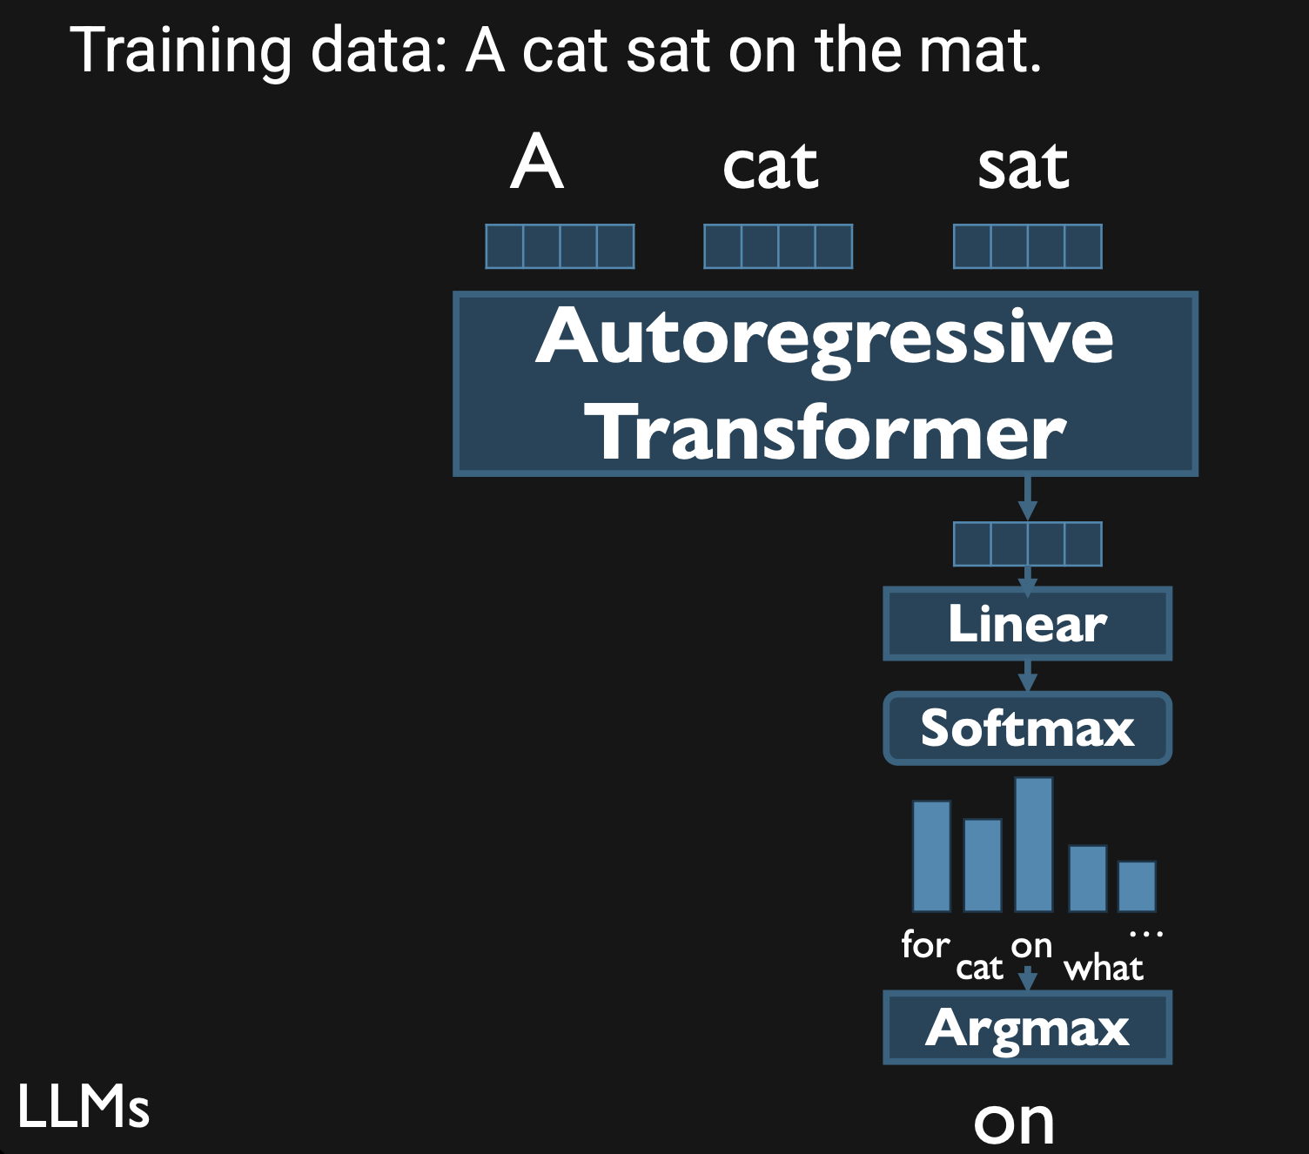
Foundational Models

Slide 28
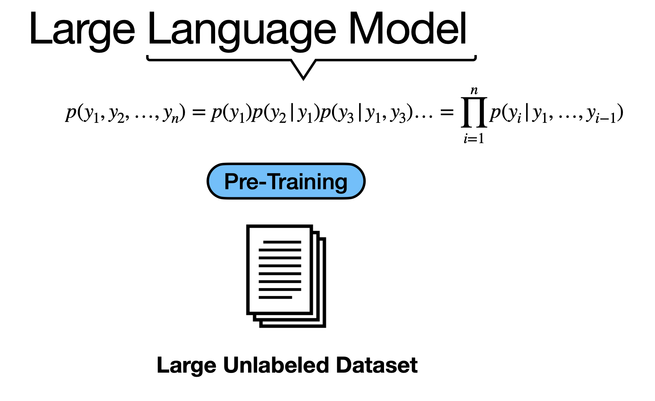
Foundational Models

Slide 29
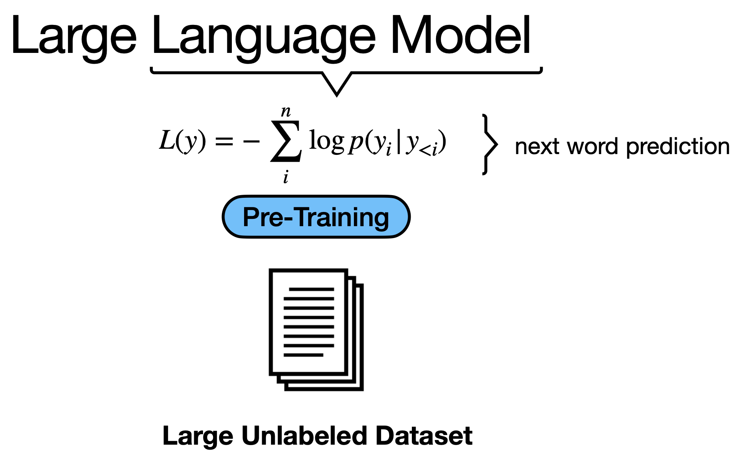
Foundational Models

Slide 30
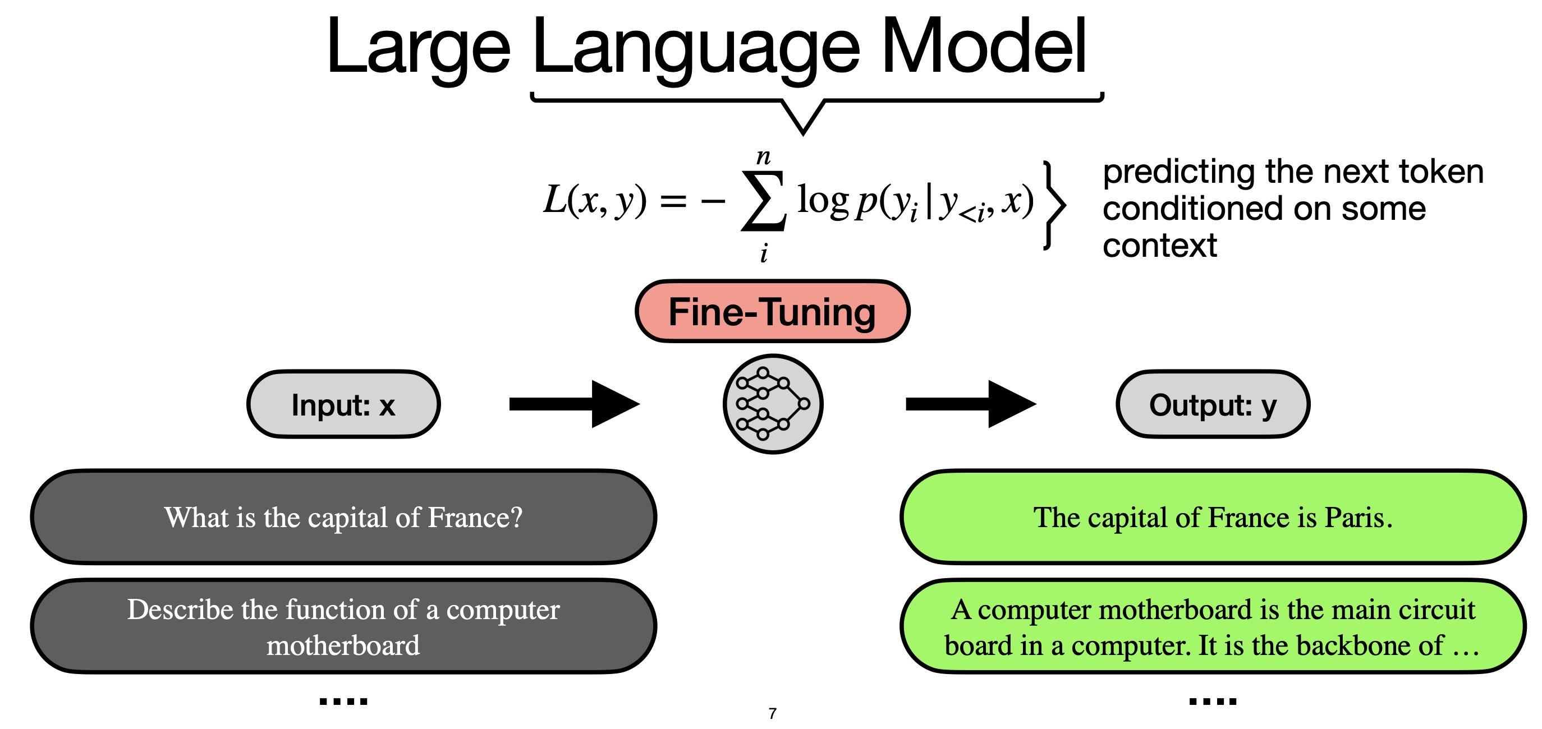
Foundational Models
Kianté Brantley: https://xkianteb.github.io

Slide 31
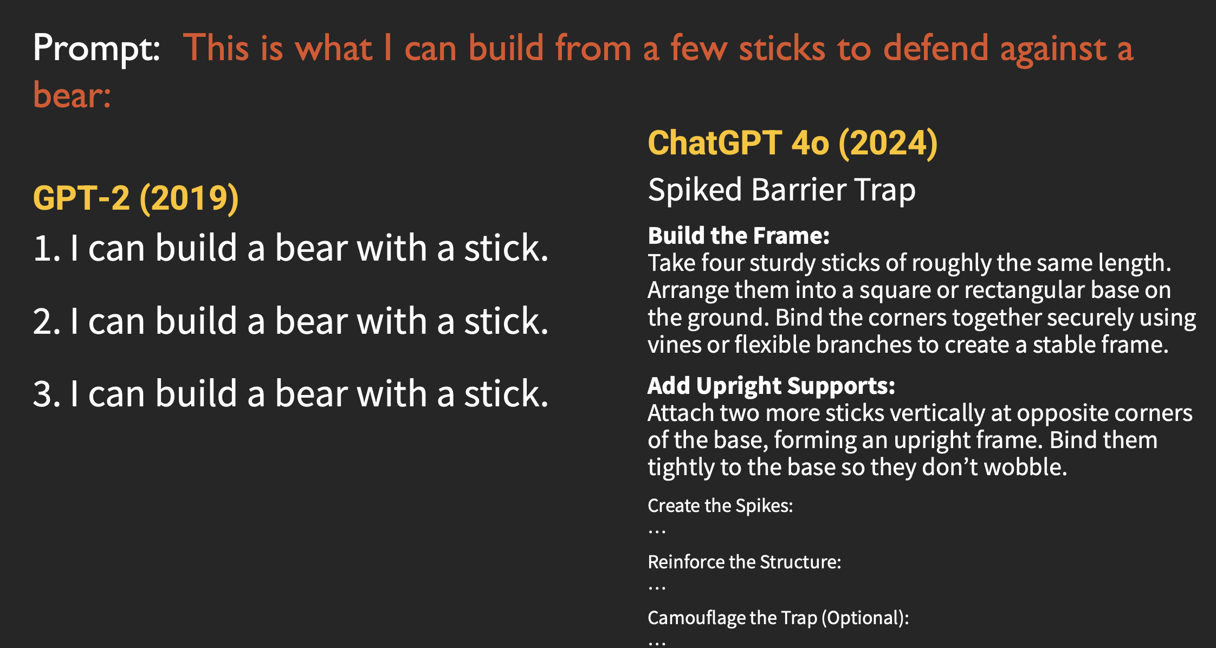
Foundational Models

Slide 32
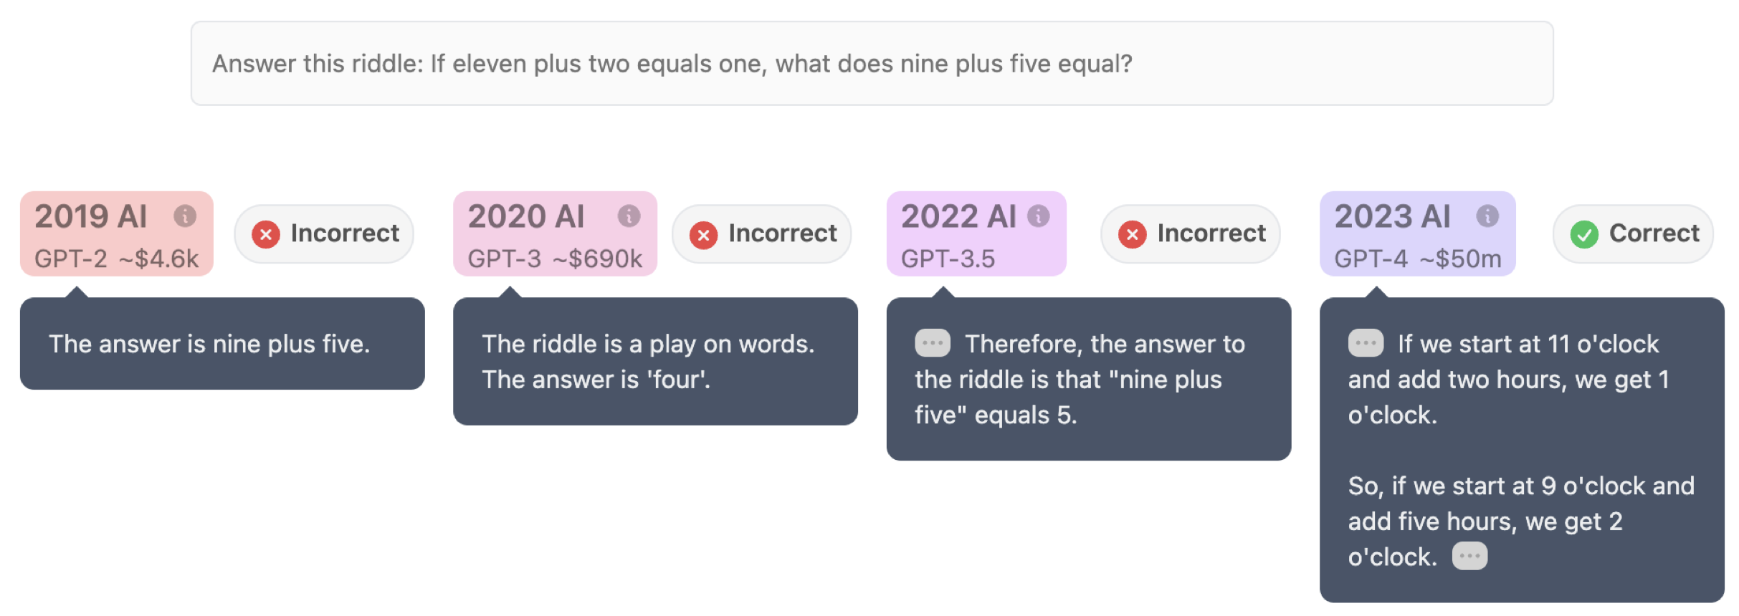
Foundational Models
https://www.reddit.com/r/ChatGPT/comments/17h0hyr/i_made_a_site_where_you_can_ask_the_same_question/

Slide 33
Foundational Models: Problems
“Making language models bigger does not
inherently make them better at following a user’s
intent. For example, large language models can
generate outputs that are untruthful, toxic, or
simply not helpful to the user. In other words,
these models are not aligned with their users.”
Long Ouyang et al.
Training language models to follow
instructions with human feedback
OpenAI 2022

Slide 34
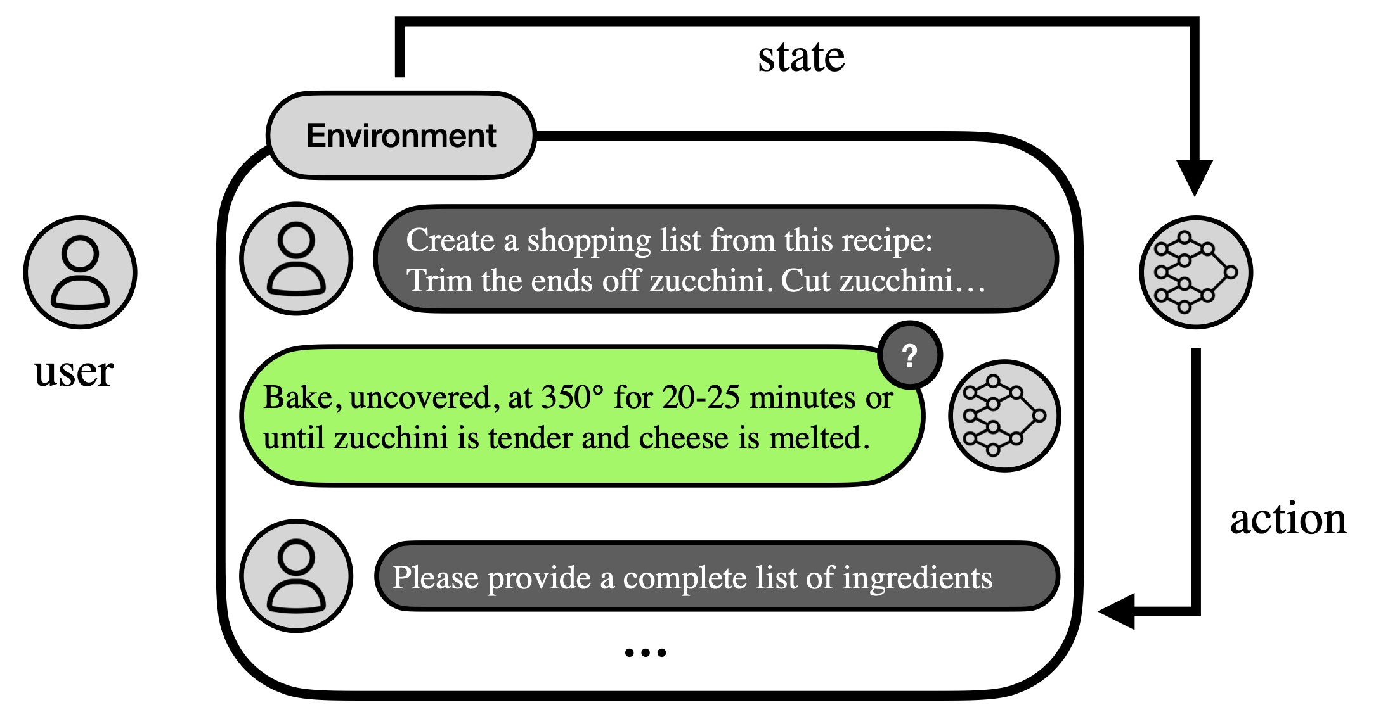
Foundational Models: improvements
Training language models to follow instructions with human feedback Ouyang et al. 2022

Slide 35
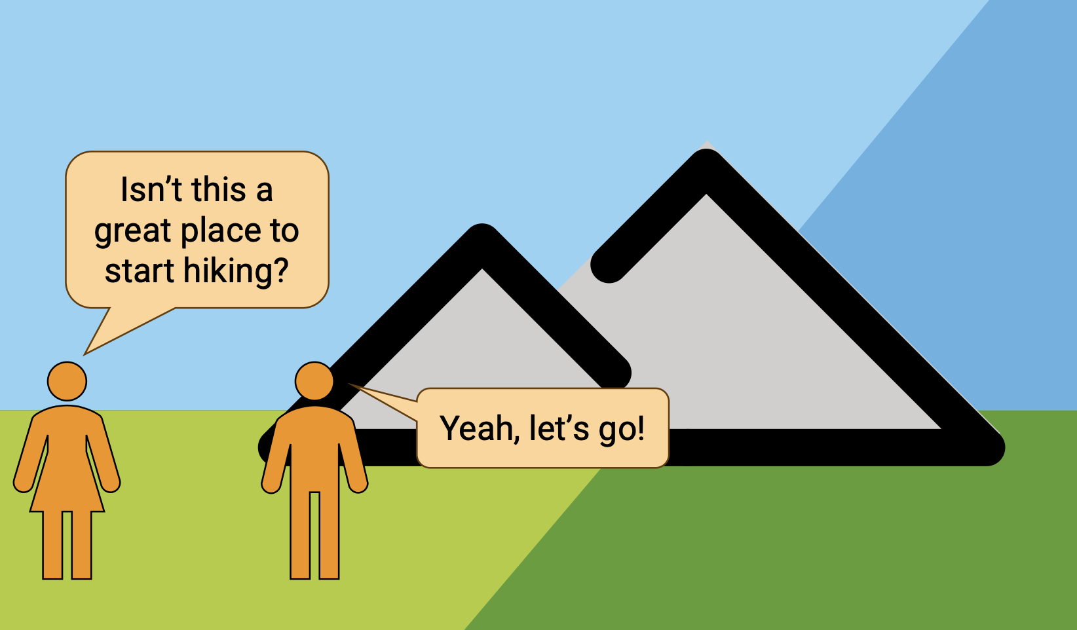
Foundational Models: improvements

Slide 36
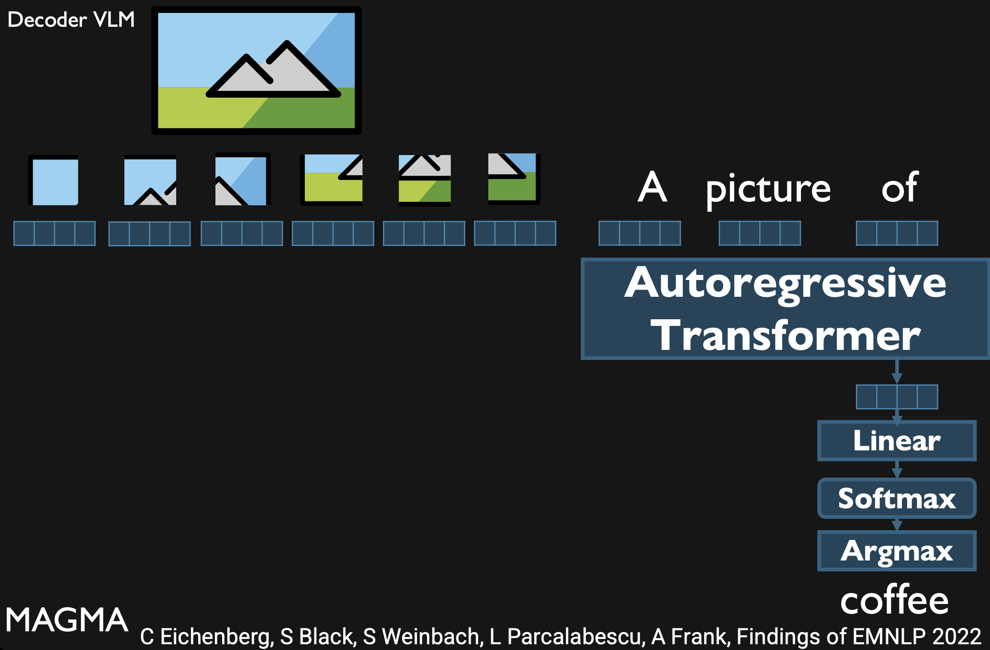
Foundational Models: improvements

Slide 37
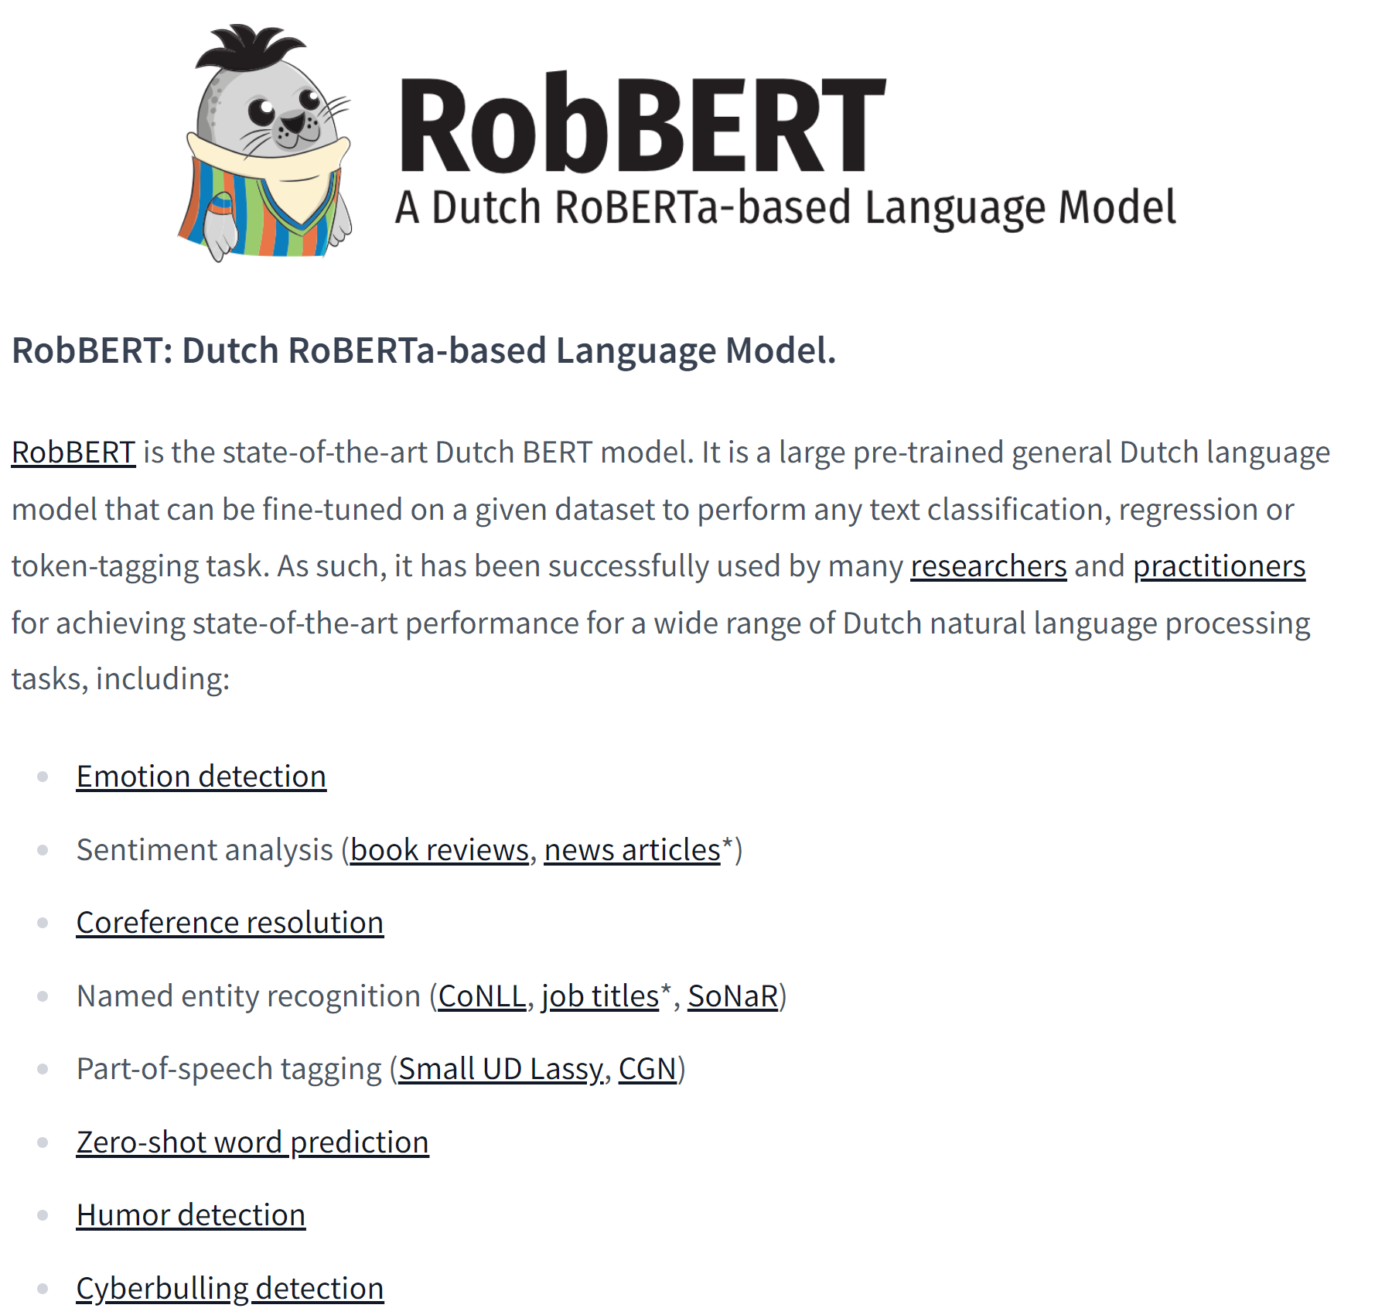
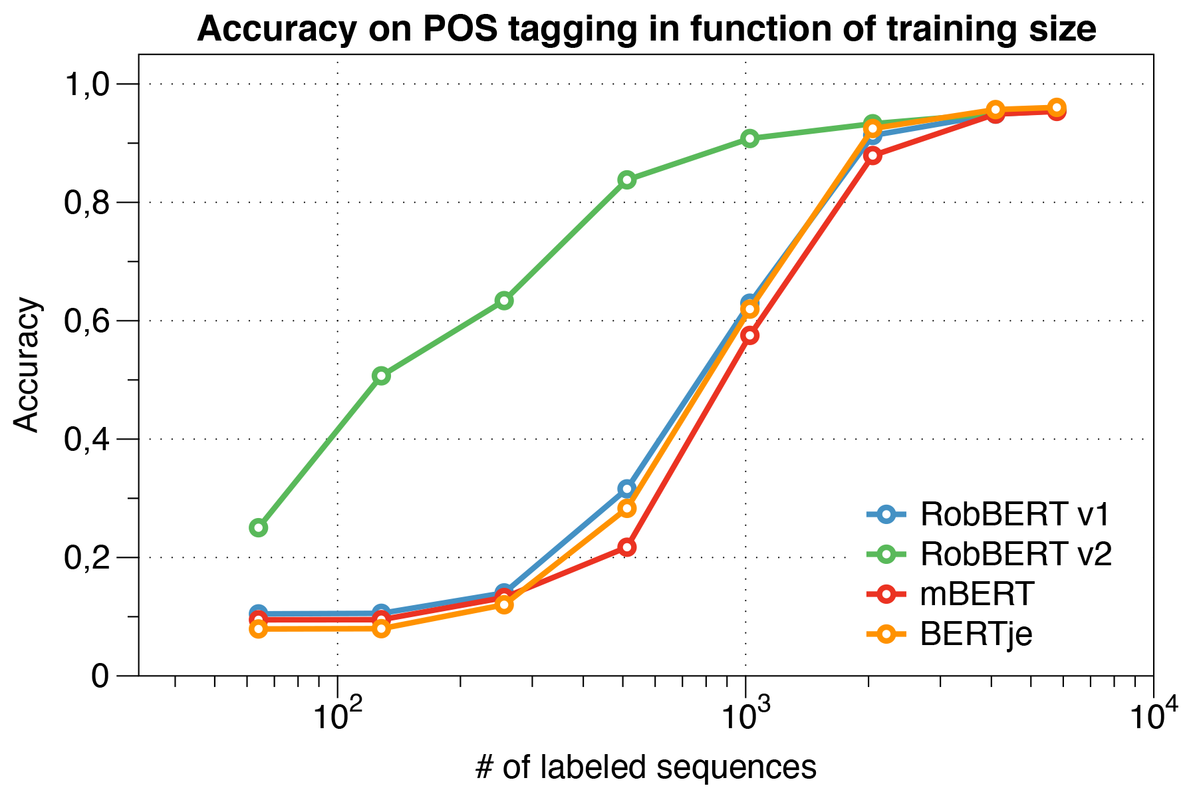
Dutch language models

Slide 38
Conclusion
Neural networks are popular methods especially for text mining
Feed-forward & RNN & CNN
RNN works better for text data
Large Language Models such as GPT are based on RNN and attention deep learning layer.

Slide 39
Practical 8

Slide 40
Questions?

